Slide 1
Systemic diseases manifested in jaws

Slide 2
INTRODUCTION
Disorders of the endocrine system, bone metabolism, and other systemic diseases may have an effect on the form and function of bone and teeth.
99% of the total body calcium is contained within the skeletal structure.

Slide 3
Radiologic features
The general changes include the following:
1. A change in size and shape of the bone
2. A change in the number, size, and orientation of trabeculae
3. Altered thickness and density of cortical structures
4. An increase or decrease in overall bone density
decrease or increase in bone density.

Slide 4
Changes to teeth and associated structures include the following:
1. Accelerated or delayed eruption
2. Hypoplasia
3. Hypocalcification
4. Loss of a distinct lamina dura

Slide 5
The systemic diseases that are manifested in jaws may be broadly classified into
Endocrine disorders
Metabolic bone diseases due to nutritional deficiency
Blood disorders

Slide 6
Endocrine disorders
–Parathyroid gland: hyper & hypoparathyroidism
–Pituiatry gland: hyper & hypopituitarism
–Thyroid gland: hyper & hypo thyroidism
–Adrenal gland: Cushing syndrome
Bone metabolism disorders
–Vitamin D related: Rickets, Osteomalacia. Renal osteodystrophy, Hypophosphatemia
–Osteoporosis, hypophosphatasia
–Osteopetrosis
Blood disorders & others
–Sickle cell anaemia
–Thalassemia
–Progressive systemic sclerosis

Slide 7
Hyperparathyroidism
Definition
Hyperparathyroidism is an endocrine abnormality in which there is an excess secretion of circulating parathyroid hormone (PTH).

Slide 8
Increases bone remodeling in
preference of osteoclastic resorption,
which mobilizes calcium from
the skeleton.
increase in serum calcium.
increases renal tubular
reabsorption of calcium and
renal production of the active vitamin D metabolite 1,25(OH)2D.

Slide 9
Etiology
Primary hyperparathyroidism usually results from a benign tumor (adenoma) of one of the four parathyroid glands, which produces excess PTH.
Less frequently, individuals may have hyperplastic parathyroid glands that secrete excess PTH.
incidence of primary hyperparathyroidism is about 0.1%.

Slide 10
Secondary hyperparathyroidism results from a compensatory increase in the output of PTH in response to hypocalcemia.
Teritiary hyperparathyroidism
Ectopic hyperparathyroidism

Slide 11
Clinical features
Women are two to three times more commonly affected than men by primary hyperparathyroidism.
Common age : 30 to 60 years of age.
Clinical manifestations
renal calculi
peptic ulcers
psychiatric problems
bone and joint pain.

Slide 12
Gradual loosening,
drifting, and
loss of teeth
The serum alkaline phosphatase level, a reliable indicator of bone turnover, may also be elevated in hyperparathyroidism.

Slide 13
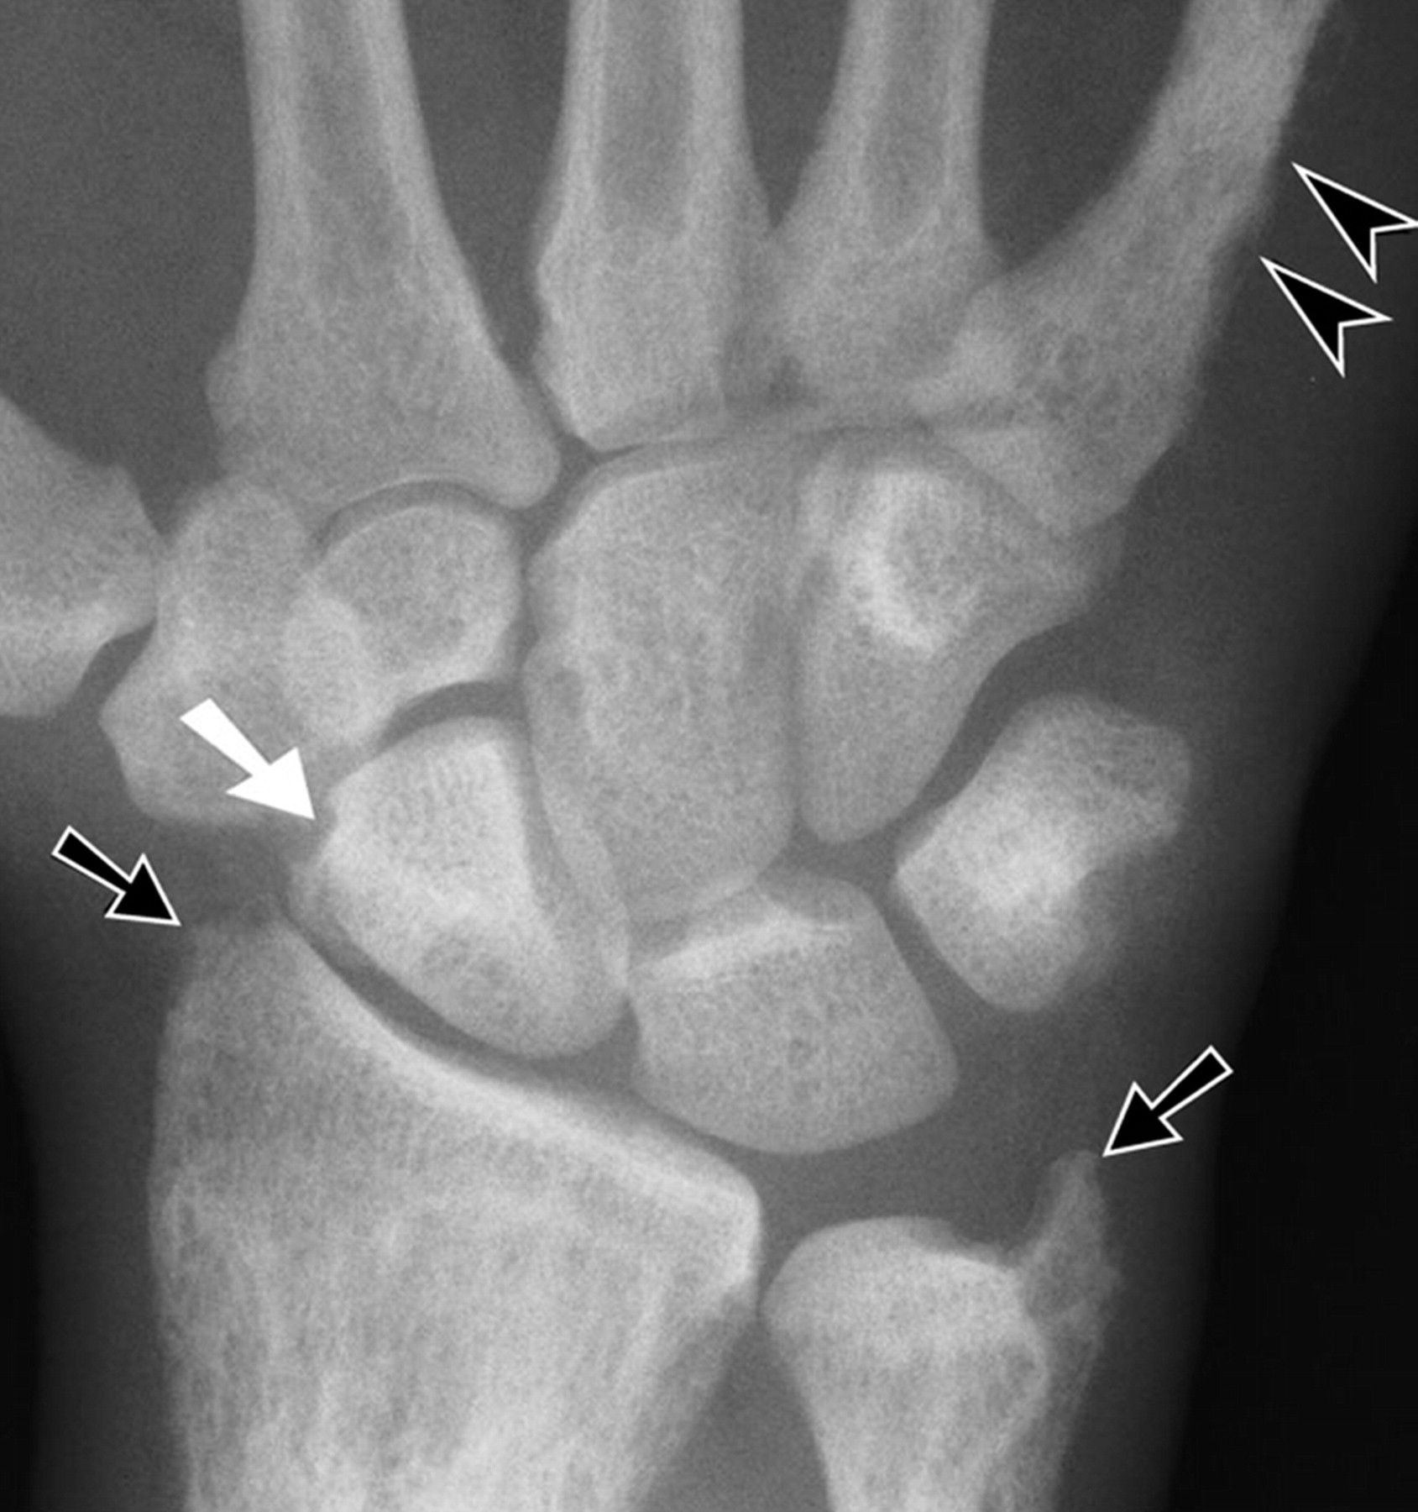
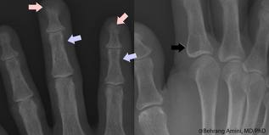
General radiographic features:
1.The earliest and most reliable changes of hyperparathyroidism are subtle erosions of bone from the subperiosteal surfaces of the phalanges of the hands.
2. Demineralization of the skeleton results in an unusual radiolucent appearance.

Slide 14
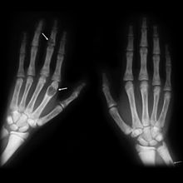
Osteitis fibrosa cystica are localized regions of bone loss produced by osteoclastic activity, resulting in a loss of all apparent bone structure.

Slide 15
4. Brown tumors occur late in the disease and in about 10% of cases. These peripheral or central tumors of bone are radiolucent. The gross specimen has a brown or reddish-brown color.
5. Pathologic calcifications in soft tissues have a punctate or nodular appearance and occur in the kidneys and joints.
6. In prominent hyperparathyroidism, the entire calvarium has a granular appearance caused by the loss of central (diploic) trabeculae and thinning of the cortical tables.

Slide 16
Radiographic features of the jaws:
Demineralization and thinning of cortical boundaries often occur in the jaws in cortical boundaries such as the
inferior border,
mandibular canal,
cortical outlines of the maxillary sinuses.
The density of the jaws is decreased, resulting in a radiolucent appearance that contrasts with the density of the teeth.

Slide 17
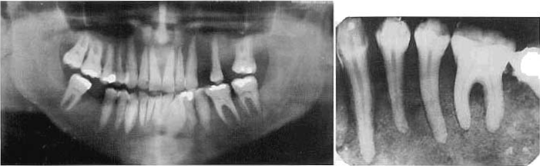
The teeth stand out in contrast to the radiolucent jaws .
A change in the normal trabecular pattern may occur, resulting in a ground-glass appearance of numerous, small, randomly oriented trabeculae.

Slide 18
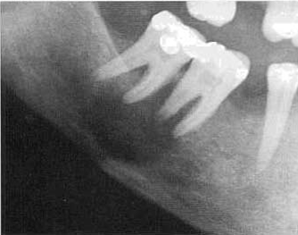
Brown tumors - any bone ,frequently found in the facial bones and jaws, particularly in long-standing cases of the disease.
multiple within a single bone. They have variably defined margins and may produce cortical expansion.

Slide 19
If solitary- resemble a
central giant cell granuloma
aneurysmal bone cyst.
the histologic appearance of the brown tumor is identical to that of the giant cell granuloma.
if a giant cell granuloma occurs later than the second decade, the patient should be screened for an
increase in serum calcium
PTH
alkaline phosphatase

Slide 20
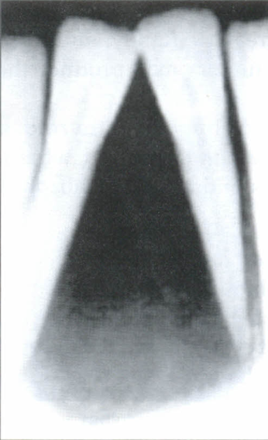
Radiographic features of the teeth and associated structures:
loss of the lamina dura in patients (only about 10%)
Depending on the duration and severity of the disease- one tooth or all the remaining teeth.
complete or partial around a particular tooth.
tapered appearance .
Although PTH mobilizes minerals from the skeleton, mature teeth

Slide 21
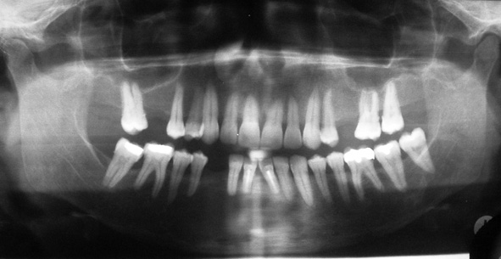
CASE REPORT
Mandibular brown tumor as the first manifestation of primary hyperparathyroidism: A case report
The Saudi Dental Journal (2011) 23

Slide 22
Management
After successful surgical removal of the causative parathyroid adenoma revert to normal.

Slide 23
HYPOPARATHYROIDISM AND
PSEUDOHYPOPARATHYROIDISM
Definition
Hypoparathyroidism is an uncommon condition in which insufficient secretion of PTH occurs.
Several causes exist
damage or removal of the parathyroid glands during thyroid surgery.
In pseudo hypoparathyroidism there is a defect in the response of the tissue target cells to normal levels of PTH.

Slide 24
Clinical Features:
sharp flexion (tetany) of the wrist
ankle joints (carpopedal spasm).
Sensory abnormalities - paresthesia of the hands, feet, or area around the mouth.
Neurologic changes- anxiety and depression, epilepsy, parkinsonism, and chorea.
Chronic forms may produce a reduction in intellectual capacity.

Slide 25
Early closure of certain bony epiphyses and thus manifest short stature or extremity disproportions.

Slide 26
Radiographic Features:
The principal radiographic change - calcification of the basal ganglia.
On skull radiographs this calcification appears flocculent and paired within the cerebral hemispheres on the posteroanterior view.

Slide 27
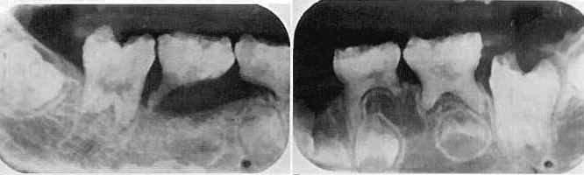
Radiographic examination of the jaws dental enamel hypoplasia
external root resorption
delayed eruption,
root dilaceration

Slide 28
Treatment
These conditions are managed with orally administered supplemental calcium and vitamin D.

Slide 29
HYPERTHYROIDISM
Thyrotoxicosis and Graves' disease
Definition
Hyperthyroidism is a syndrome that involves excessive production of thyroxin in the thyroid gland.

Slide 30
diffuse toxic goiter (Graves' disease) and less frequently with toxic nodular goiter or toxic adenoma, a benign tumor of the thyroid gland.
Each of these conditions results in increased levels of circulating thyroxin.

Slide 31
Clinical features
increase in the metabolic rate of all body tissues,
resulting in tachycardia,
increased blood pressure,
sensitivity to heat,
irritability.
Hyperthyroidism is more common in females.

Slide 32
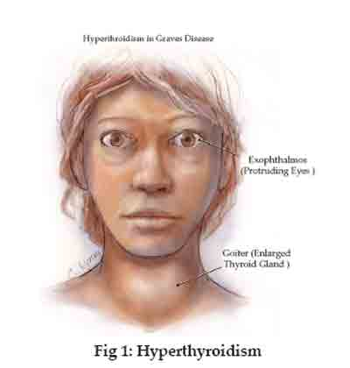
Pts may have wt loss
Amenorrhea ,oligimenorrhea ,infertility ,spontaneous abortions and loss of libido.
Exopthalmus
Increased sweating
Osteoporosis
Pt is sensitive to epinephrine
In patients with thyrotoxicosis, dental treatment can precipitate an acute emergency like thyroid crisis or thyroid storm.

Slide 33
Radiographic Features
Advanced rate of dental development and early eruption, with premature loss of the primary teeth.
Adults may show a generalized decrease in bone density or loss of some areas of edentulous alveolar bone.

Slide 34
HYPOTHYROIDISM
Synonyms
Myxedema and cretinism
Definition
Hypothyroidism usually results from insufficient secretion of thyroxin by the thyroid glands, despite the presence of thyroid-stimulating hormone.

Slide 35
Clinical Features:
retarded mental and physical development.
The base of the skull shows delayed ossification,
paranasal sinuses only partially pneumatize.

Slide 36
Dental development is delayed, and the primary teeth are slow to exfoliate.
adult – myxedematous swelling but not the dental or skeletal changes seen in children.
Adult symptoms
lethargy,
poor memory
inability to concentrate
constipation,
cold intolerance

Slide 37
more florid clinical picture of
dull and expressionless face,
periorbital edema,
large tongue
sparse hair
skin that feels "doughy" to the touch.

Slide 38
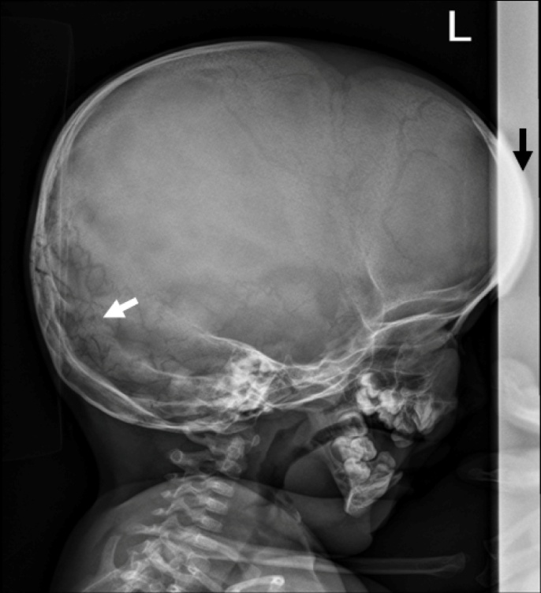
Radiographic Features
Radiographic features in children include
delayed closing of the epiphyses and skull sutures with the production of numerous wormian bones (accessory bones in the sutures).

Slide 39
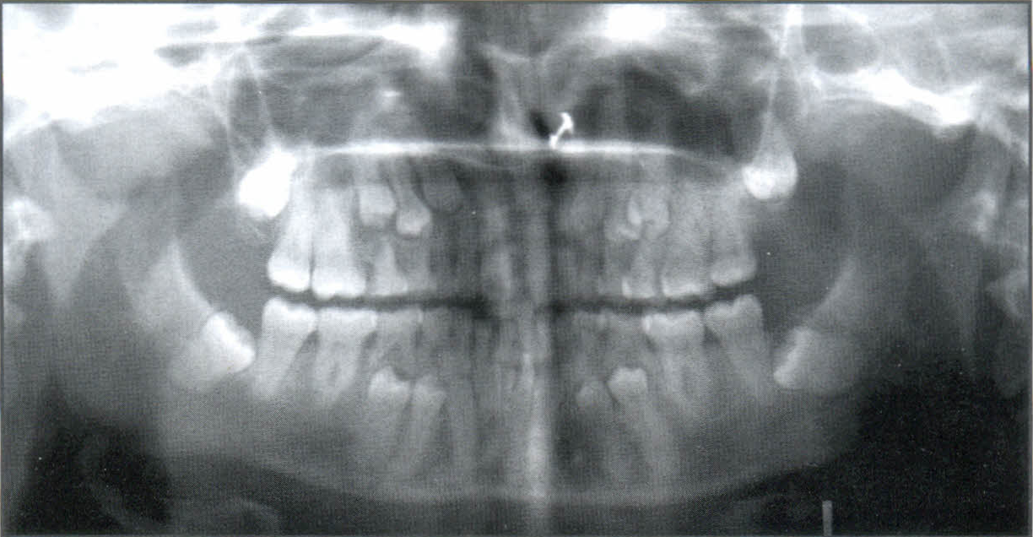
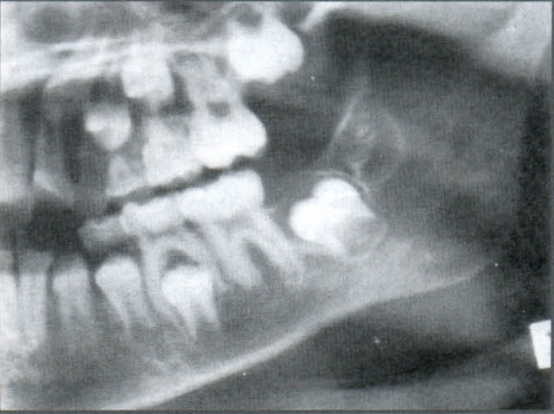
Effects on the teeth include
delayed eruption
short roots
thinning of the lamina dura.
The maxilla and mandible are relatively small.

Slide 40
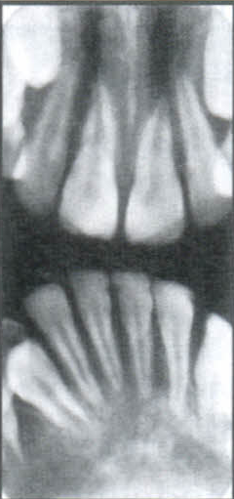
Patients with adult hypothyroidism may show
periodontal disease
loss of teeth
separation of teeth as a result of
enlargement of the tongue
external root resorption.

Slide 41
HYPERPITUITARISM
Synonyms
Acromegaly and gigantism
Definition
Hyperpituitarism results from hyperfunction of the anterior lobe of the pituitary gland, which increases the production of growth hormone.
An excess of growth hormone causes overgrowth of all tissues in the body still capable of growth.
The usual cause of this problem is a benign, functioning tumor of the acidophilic cells in the anterior lobe of the pituitary gland.

Slide 42
Clinical Features
Hyperpituitarism in children - gigantism.
Active growth occurs in those bones in which the epiphyses have not united with the bone shafts.
Throughout adolescence, generalized skeletal growth is excessive and may be prolonged.
Those affected may ultimately attain heights of 7 to 8 feet or more yet exhibit remarkably normal proportions.
The eyes and other parts of the central nervous system do not enlarge, except in rare cases in which the condition is manifested in infancy.

Slide 43
Adult hyperpituitarism – acromegaly
an excess of growth hormone can stimulate the mandible and the phalanges of the hand.
Mandibular condylar growth may be very prominent.
Also, the supraorbital ridges and the underlying frontal sinus may be enlarged.
Excess growth hormone in adults may also produce hypertrophy of some soft tissues.
The lips, tongue, nose, and soft tissues of the hands and feet typically overgrow in adults with acromegaly, sometimes to a striking degree.

Slide 44
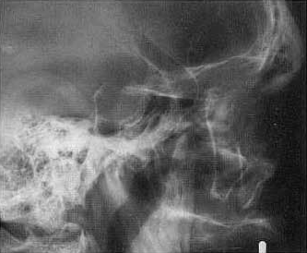
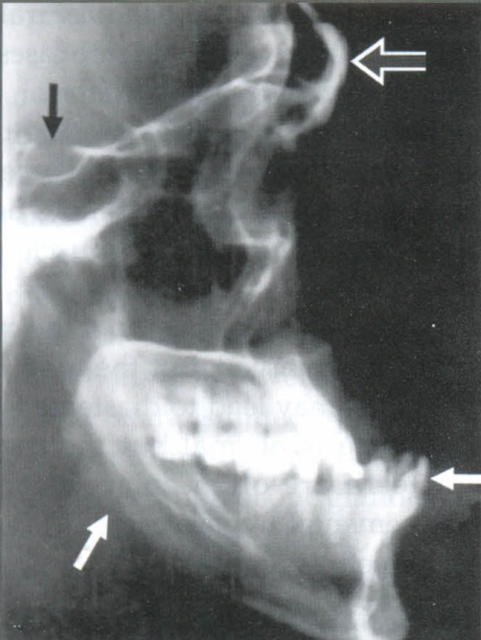
Radiographic Features
General radiographic features:
The pituitary tumor responsible for hyperpituitarism often produces enlargement ("ballooning") of the sella turcica

Slide 45
Skull radiographs characteristically reveal enlargement of the paranasal sinuses (especially the frontal sinus).
These air sinuses are more prominent in acromegaly than in pituitary gigantism because sinus growth in gigantism tends to be more in step with the generalized enlargement of the facial bones.
Hyperpituitarism in adults also produces diffuse thickening of the outer table of the skull.

Slide 46
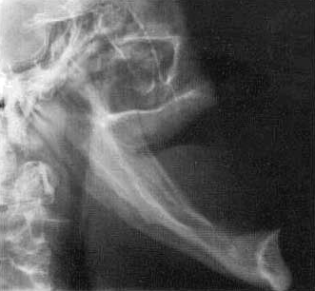
Radiographic features of the jaws:
Hyperpituitarism causes enlargement of the jaws, most notably the mandible .

Slide 47
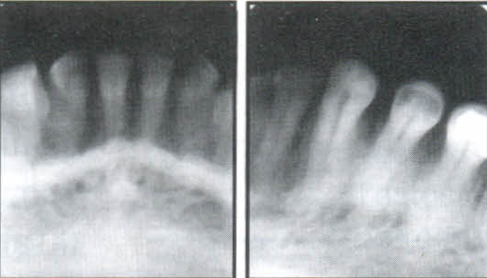
The increase in the length of the dental arches results in spacing of the teeth.
In acromegaly the angle between the ramus and body of the mandible may increase.
combination with enlargement of the tongue (macroglossia), may result in anterior flaring of the teeth and the development of an anterior open bite.

Slide 48
The sign of incisor flaring is a helpful point of differentiation between acromegalic prognathism and inherited prognathism.
In acromegaly the most profound growth occurs in the condyle and ramus, often resulting in a class III skeletal relationship between the jaws.
The thickness and height of the alveolar processes may also increase.

Slide 49
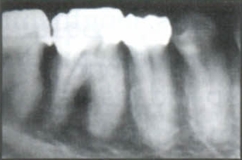
Radiographic changes associated with the teeth:
The tooth crowns are usually normal in size, although the roots of posterior teeth often enlarge as a result of hypercementosis.
This hypercementosis may be the result of functional and structural demands on teeth instead of a secondary hormonal effect.
Supereruption of the posterior teeth may occur in an attempt to compensate for the growth of the mandible.

Slide 50
Management:
Medical therapy, surgery and radiotherapy.

Slide 51
HYPOPITUITARISM
Definition
Hypopituitarism results from reduced secretion of pituitary hormones.

Slide 52
Clinical Features
Dwarfism -relatively well-proportioned bodies.
The dimensions of the bones in these adults were approximately the same as those of normal children 5 to 7 years of age.
When it occurs in adults or after puberty it is called Simmond's Disease or Pituitary Cachexia.
Total absence of pituitary secretions is known as Panhypopituitarism.

Slide 53
Radiographic Features
Eruption of the primary dentition occurs at the normal time, but exfoliation is delayed by several years.
The crowns of the permanent teeth form normally, but their eruption is delayed several years.
The third molar buds may be completely absent.
In hypopituitarism the jaws are small, especially the mandible; this results in crowding and malocclusion.

Slide 54
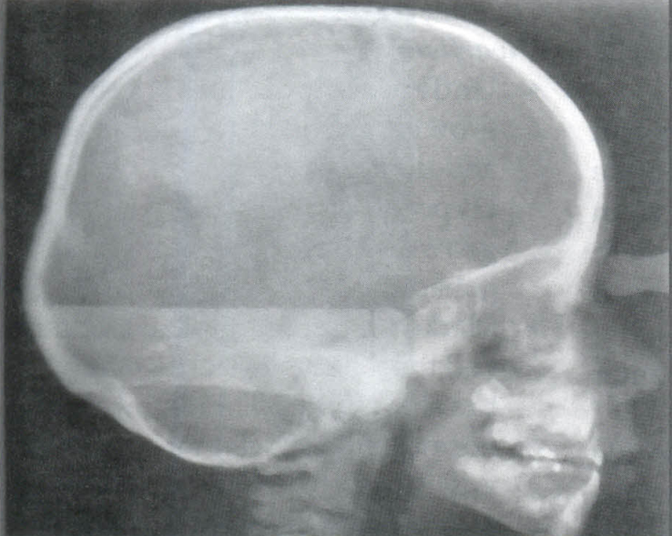
Marked failure of the development of the maxilla and the mandible, lack of condylar growth leading to a short ramus.
The dental arches are smaller than normal and thus cannot accommodate all the teeth and may result in severe malocclusion and crowding of the teeth.
Osseous development of the maxilla is not as retarded as that of the mandible, leading to retrusion of the chin.

Slide 55
Treatment:
Treatment is usually directed toward removal of the cause or replacement of the pituitary hormones or those of its target gland.
The response of the dentition to treatment with growth hormone is variable but seems to parallel skeletal response.

Slide 56
DIABETES MELLITUS
Definition
Diabetes mellitus is a metabolic disorder that has two primary forms.
Type 1, insulin-dependent diabetes mellitus
(previously known as juvenile-onset diabetes)
Type 2, noninsulin dependent diabetes mellitus, results from insulin resistance.

Slide 57
Clinical Features
polydipsia (excessive intake of fluids),
polyuria (excessive urination),
acetone present in the urine and on the breath.
lowers the resistance of the body to infection.

Slide 58
Diabetes may demonstrate a number of adverse effects in the oral cavity.
Accelerates periodontal disease.
children with uncontrolled diabetes have an increased likelihood of caries activity because of a high carbohydrate diet.
xerostomia resulting from a reduced salivary flow (about one third of normal).

Slide 59
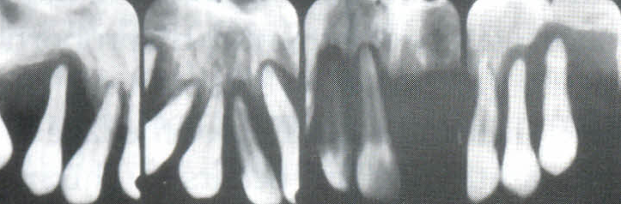
Radiographic Features
Periodontal disease associated with diabetes is indistinguishable radiographically from periodontal disease in patients without diabetes.

Slide 60
CUSHING'S SYNDROME
Definition
Cushing's syndrome arises from an excess of secretion of glucocorticoids by the adrenal glands. This may result from any of the following:
1. An adrenal adenoma
2. An adrenal carcinoma
3. Adrenal hyperplasia (usually bilateral)
4. A basophilic adenoma of the anterior lobe of the pituitary gland {Cushing's disease), producing excess adrenocorticotropic hormone (ACTH)
5. Medical therapy with exogenous corticosteroids

Slide 61
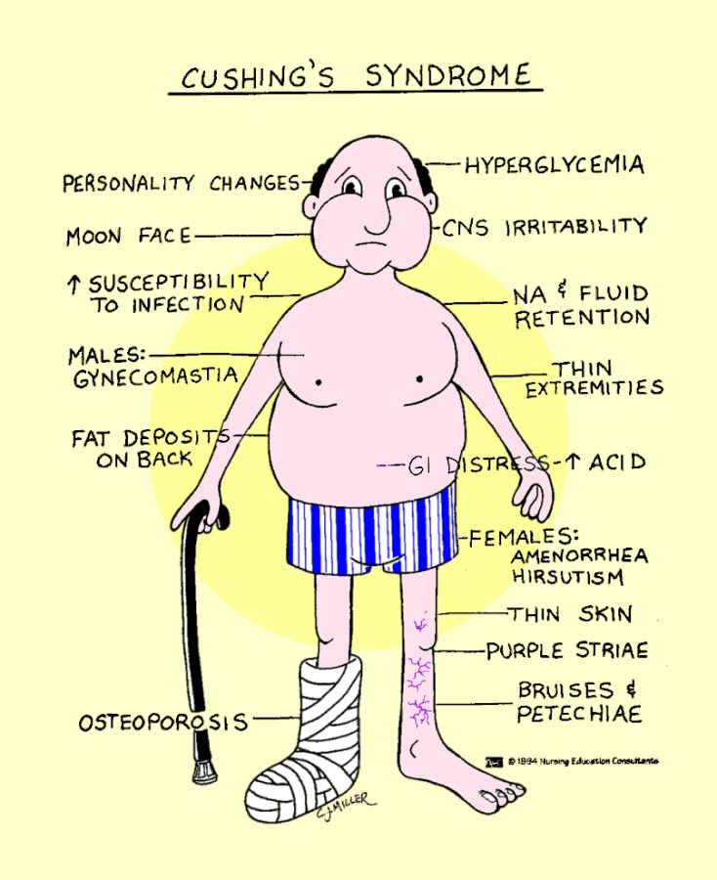
Clinical Features
Patients with Cushing's syndrome often show obesity (which spares the extremities), kyphosis of the thoracic spine ("buffalo hump"), weakness, hypertension, striae, or concurrent diabetes.

Slide 62
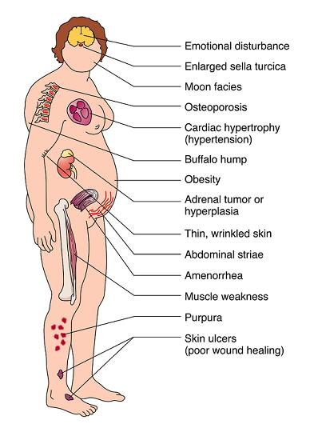

Slide 63
This condition affects females three to five times as frequently as males.
Onset may occur at any age but is usually seen in the third or fourth decade.

Slide 64
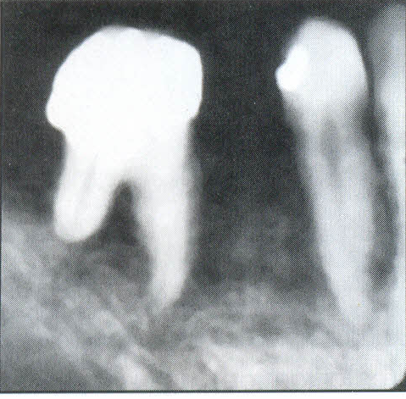
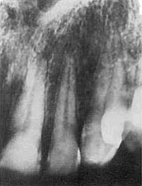
Radiographic Features
generalized osteoporosis - granular bone pattern.
pathologic fractures.
The skull can show diffuse thinning accompanied by a mottled appearance.
The teeth may erupt prematurely, and partial loss of the lamina dura may occur

Slide 65
OSTEOPOROSIS
Definition
Osteoporosis is a generalized decrease in bone mass in which the histologic appearance of bone is normal.
An imbalance occurs in bone resorption and formation.
Decrease in bone formation results in a lower trabecular bone volume and thinning of cortical bone and trabeculae.

Slide 66
Osteoporosis occurs with the aging process of bone and can be considered a variation of normal (primary osteoporosis).
Bone mass normally increases from infancy to about 35 to 40 years of age.
At this time there begins a gradual and progressive decline, occurring at the rate of about 8% per decade in women and 3% per decade in men.

Slide 67
Secondary osteoporosis may result from nutritional deficiencies, hormonal imbalance, inactivity, or corticosteroid or heparin therapy.

Slide 68
Clinical Features
The most important clinical manifestation of osteoporosis is fracture.
The most common locations are the distal radius, proximal femur, ribs, and vertebrae.
Patients may suffer from bone pain.
The population most at risk is postmenopausal women.

Slide 69
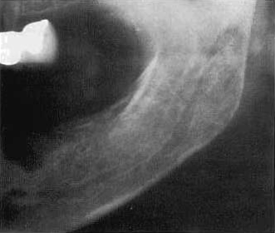
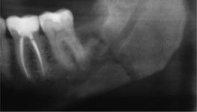
Radiographic Features
overall reduction in the density of bone.
In the jaws by using the unaltered density of teeth as a comparison.
Reduced density and thinning of cortical boundaries such as the inferior mandibular cortex .

Slide 70
Number of trabeculae is least evident in the alveolar process, possibly because of the constant stress applied to this region of bone by the teeth.
On occasion the lamina dura may appear thinner than normal.
In other regions of the mandible a reduction in the number of trabeculae may be evident.

Slide 71
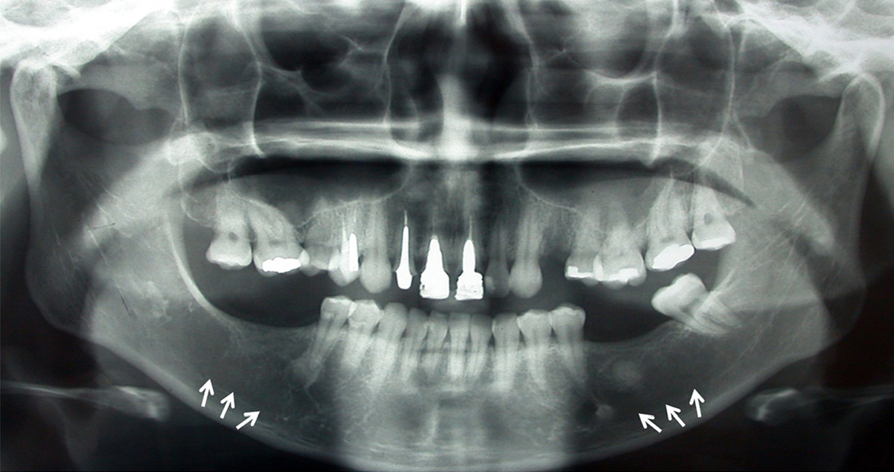
Bilateral osteoporotic bone marrow defects of the mandible: a case report
Bravo-Calderón et al. Head & Face Medicine 2012,

Slide 72
Treatment
The administration of estrogens and calcium supplements after menopause helps to prevent further cortical and trabecular bone loss.
Exercise programs are also effective.

Slide 73
METABOLIC BONE DISEASES DUE TO
NUTRITIONAL DEFICIENCY
Nutritional deficiencies may be broadly divided into:
• Primary Nutritional Deficiencies- caused due to inadequate intake.
• Secondary Nutritional Deficiencies- caused due to a number of predisposing factors and conditions, such as:
- Increased metabolic rate
- Malabsorption
-Functional or organic GI Tract disorders
- Increased excretion of essential factors

Slide 74
Vitamin A Deficiency
Definition:
Carotene is a yellow pigment found in vegetable foods which is converted into Vitamin A in the body.
Vitamin A or retinol is also found in foods of animal origin.
The daily requirement of Vitamin A is 420 mg to 800-1000 mg.

Slide 75
Clinical Features
Causes failure of growth in the young and collagenous tissue is affected.
Keratinizing metaplasia of the epithelial cells.
Deficiency causes night blindness, dry conjunctiva, Bitot's spot, corneal xerosis, corneal ulcerations or keratomalacia.
There may be xerophthalmia due to decrease in lacrimal secretion.

Slide 76
The teeth have defective enamel formation with distorted morphology, enamel hypoplasia, and atypical dentin.
There is increased susceptibility to caries, hyperplastic gingival and periodontal disease with abscess formation.

Slide 77
Radiographic Features
Widening of the periodontal membrane is seen, and at times the loss of periodontal space is so severe that roots are seen in direct contact with the alveolar bone.

Slide 78
Langerhan's Cell Histiocytosis (histiocytosis X, idiopathic histiocytosis, /angerhan's cell disease)
Histiocytosis-X was classified into three distinct clinical forms:
- Eosinophilic granuloma (solitary)
- Hand-Schuller-Christian disease (chronic dissemina ted)
- Letterer-siwe disease (acute disseminated).

Slide 79
Eosinophilic Granuloma
This is more common in males, older children and young adults are more affected.
It usually involves the skeleton (ribs, pelvis, long bones, skull and jaws) and in rare cases it involves soft tissue (such as lymph nodes, skin, lungs, gingiva and palate)
The lesions develop quickly and may be painful.
It is usually destructive, well demarcated, roughly round or oval in shape.
The destroyed area is replaced by soft tissue (soft and brown) which eventually becomes fibrous and grayish.

Slide 80
In the jaws there is evidence of bony swelling, loosening and sloughing of teeth due to destruction of the alveolar bone by one or more foci of EG.
There may be superficial loss of alveolar bone, often mimicking juvenile periodontitis.
The patient may have a soft tissue mass, gingivitis, bleeding gingiva, pain and ulceration.
The sockets of teeth lost to the disease generally do not heal normally.

Slide 81
Hand-Schuller-Christian Disease
This usually begins in childhood, but sometimes may not develop until the third decade.
Males are more commonly affected.
The patient may have otitis media and papular or nodular lesions on the skin.
The facial bone is commonly affected with associated soft tissue swelling, tenderness and facial asymmetry.

Slide 82
The patient shows a triad of single or multiple areas of punched out bone destruction in the skull unilateral or bilateral exophthalmus and diabetes insipidus.
Oral manifestations include sore mouth with or without ulcerative lesions, halitosis, gingivitis, loose or sore teeth, failure of extraction socket to heal, loss of alveolar bone.
Many cases end fatally.

Slide 83
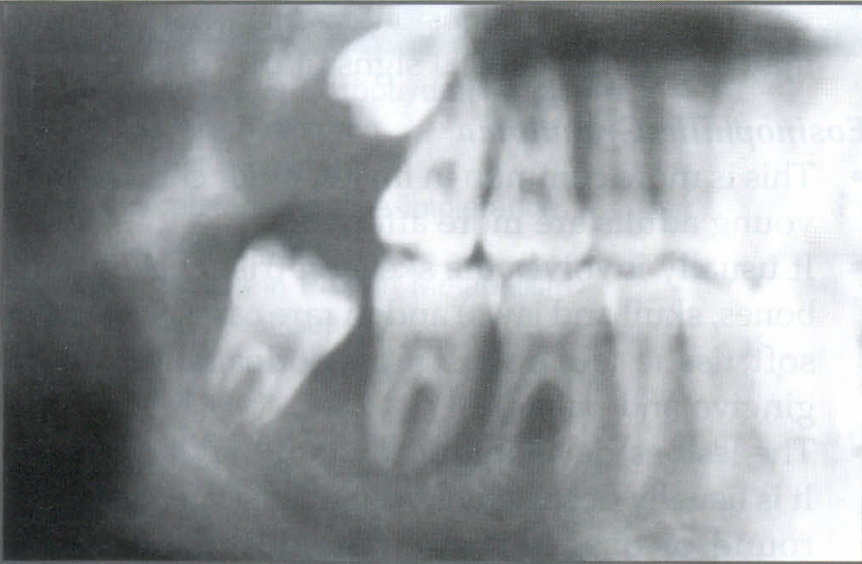
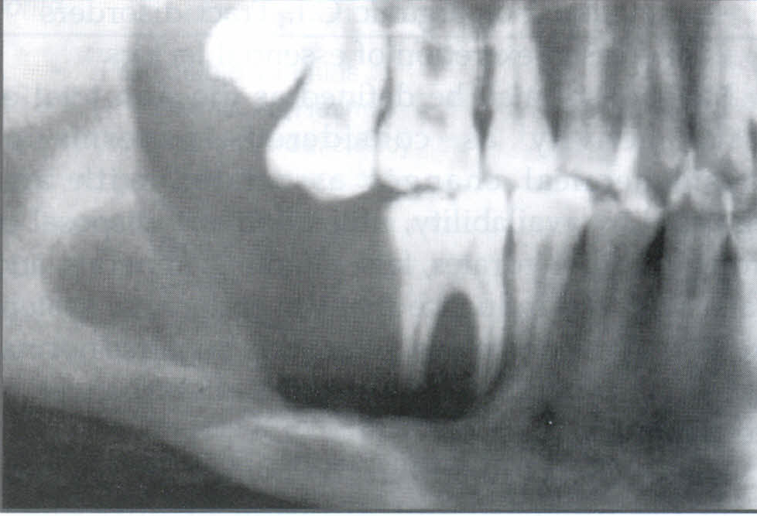
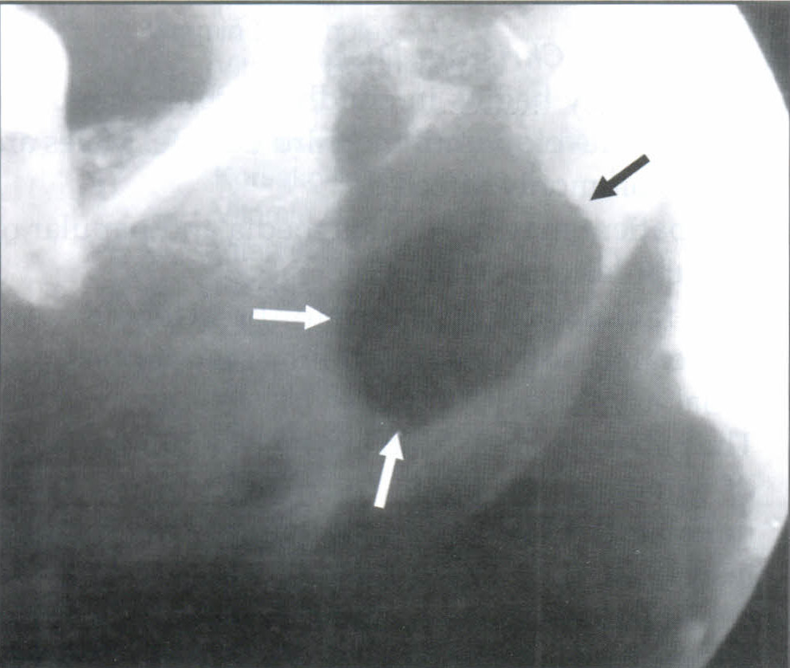

Slide 84
Letterer-Siwe Disease
This is a malignant form of LCH, which is a fulminating condition, often occurs in infants below 3 years of age.
The initial onset is manifested as skin rash involving the trunk, scalp and extremities.
The rash may be erythematous, purpuric and ecchymotic sometimes it may be ulcerative.

Slide 85
The oral cavity is affected with multiple ulcers and enlargement of the gingival tissues.
There is diffuse destruction of the maxilla and mandible leading to loosening and premature loss of teeth.

Slide 86
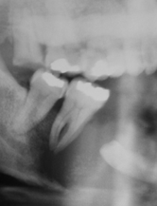
Differential Diagnosis
Oral carcinoma-found in the older age group, the borders are more irregular.

Slide 87
Periodontal Disease-the epicenter of bone destruction in LCH is approximately at the midroot region, resulting in a scooped out appearance.
In contrast, the bone destruction in periodontal disease starts at the alveolar crest and extends apically down the root surface and it usually has condensing osteitis around the lesion.

Slide 88
RICKETS AND OSTEOMALACIA
Definition
Rickets and osteomalacia result from inadequate serum and extracellular levels of calcium and phosphate minerals required for the normal calcification of bone and teeth.
Both abnormalities result from a defect in the normal activity of the metabolites of vitamin D, especially 1,25(OH)2D, required for resorption of calcium in the intestine.

Slide 89
The term rickets is usually applied when the disease affects the growing skeleton in infants and children.
The term osteomalacia is used when this disease affects the mature skeleton in adults.

Slide 90
Failure of normal activity of vitamin D may occur as a result of the following:
1. Lack of vitamin D in the diet
2. Lack of absorption of vitamin D resulting from various gastrointestinal malabsorption problems
3. Lack of metabolism of the active metabolite 1,25(OH)2D that is required for intestinal absorption of calcium.

Slide 91
Interference may occur anywhere along the metabolic pathway for 1,25(OH)2D:
1. Lack of exposure to ultraviolet light required for conversion of provitamin D3
2. Lack of conversion of vitamin D3 to 25(OH)D in the liver because of liver disease
3. Lack of metabolism of 25(OH)D2 to1,25(OH)2D by the kidney because of kidney diseases
4. A defect in the intestinal target cell response to 1,25(OH)2D or inadequate calcium supply

Slide 92
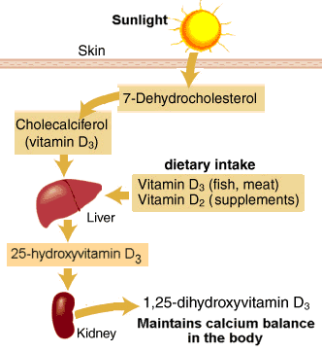

Slide 93
Clinical Features
Rickets:
In the first 6 months of life, tetany or convulsions are the most common clinical problems resulting from the hypocalcemia of rickets.
Later in infancy the skeletal effects of the disease may be more clinically prominent.
Craniotabes, a softening of the posterior of the parietal bones, may be the initial sign of the disease.
The wrists and ankles typically swell.
Children with rickets usually have short stature and deformity of the extremities.
Development of the dentition is delayed, and the eruption rate of the teeth is retarded.

Slide 94
Osteomalacia:
Most patients with osteomalacia have some degree of bone pain.
The majority of patients with osteomalacia have muscle weakness of varying severity.
Other clinical features include a peculiar waddling or "penguin" gait, tetany, and greenstick bone fractures.

Slide 95
Radiographic Features
General radiographic features:
In rickets the earliest and most prominent radiographic manifestation is a widening and fraying of the epiphyses of the long bones.
The soft weight-bearing bones such as the femur and tibia undergo a characteristic bowing.
Greenstick fractures ,(an incomplete fracture) occur in many patients with rickets.

Slide 96
In osteomalacia the cortex of bone may be thin.
Pseudofractures, which are poorly calcified, ribbon like zones extending into bone at approximate right angles to the margin of the bone, may also be present.
Pseudofractures occur most commonly in the ribs, pelvis, and weight-bearing bones and rarely in the mandible.

Slide 97
Radiographic features of the jaws:
In rickets, jaw cortical structures, such as the inferior mandibular border or the walls of the mandibular canal, may thin.
Changes in the jaws generally occur after changes in the ribs and long bones.
Within the cancellous portion of the jaws, the trabeculae become reduced in density, number, and thickness.
In severe cases, the jaws appear so radiolucent that the teeth appear to be bereft of bony support.

Slide 98
Most cases of osteomalacia produce no radiographic manifestations in the jaws.
However, there may be an overall radiolucent appearance and sparse trabeculae.

Slide 99
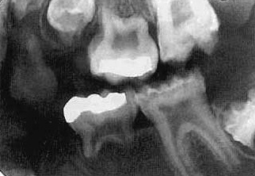
Radiographic changes associated with the teeth:
Rickets in infancy or early childhood may result in hypoplasia of developing dental enamel .
If the disease occurs before 3 years, such enamel hypoplasia is fairly common.
Radiographs may reveal this early manifestation of rickets in unerupted and erupted teeth.
Radiographs may also document retarded tooth eruption in early rickets.

Slide 100
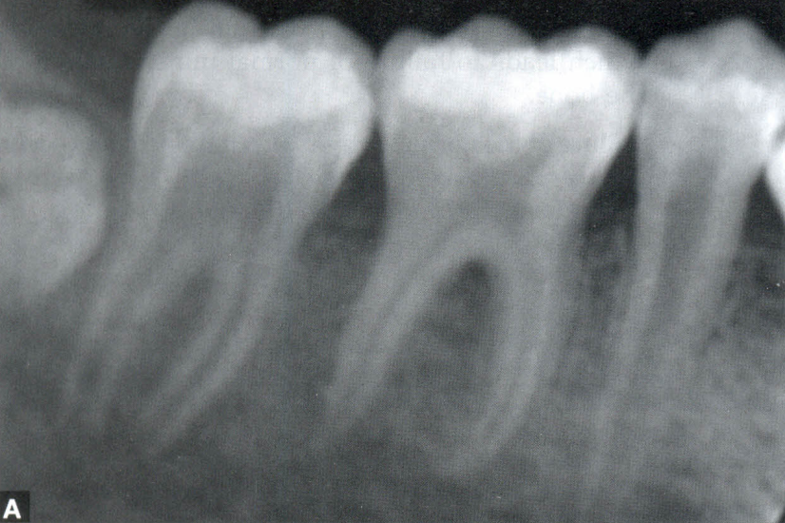
The lamina dura and the cortical boundary of tooth follicles may be thin or missing.
Osteomalacia does not alter the teeth because they are fully developed before the onset of the disease.
The lamina dura may be especially thin in individuals with long-standing or severe osteomalacia.

Slide 101
Hypophosphatasia
Definition
Hypophosphatasia is a rare inherited disorder that is caused by either a reduced production or a defective function of alkaline phosphatase.
This enzyme is required for normal mineralization of osteoid.
Patients have a low level of serum alkaline phosphatase activity and elevated urinary excretion of phosphoethanolamine.
The usual pattern of inheritance is an autosomal dominant mode of disease transmission

Slide 102
Clinical features
The disease in individuals with homozygous involvement usually begins in utero, and affected patients often die within the first year.
These infants demonstrate bowed limb bones and a marked deficiency of skull ossification.
Individuals with heterozygous disease show the biochemical defects but a milder disease clinically.
These children show poor growth, fractures, and deformities similar to rickets.
A history may exist of fractures, delayed walking, or rickets-like deformities that heal spontaneously

Slide 103
About 85% of these children show premature loss of the primary teeth, particularly the incisors, and delayed eruption of the permanent dentition.
This is often the first clinical sign of hypophosphatasia.

Slide 104
Radiographic Features
General radiographic features:
In young children with hypophosphatasia the long bones show irregular defects in the epiphysis, and the skull is poorly calcified.
In older children with premature closure of the skull sutures, multiple lucent areas of the calvarium may exist, called gyral or convolutional markings.
These markings resemble hammered copper.
The skull may assume a brachycephalic shape.
A generalized reduction in bone density may occur in adults.

Slide 105
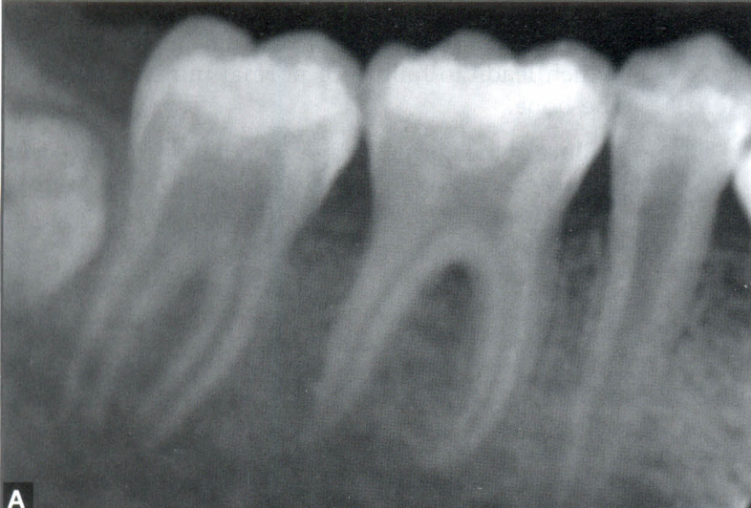
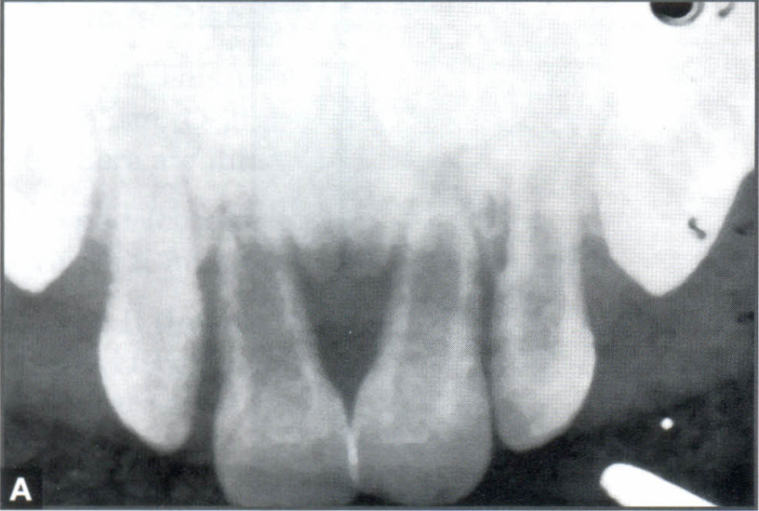
Radiographic features of the jaws:
A generalized radiolucency of the mandible and maxilla is evident.
The cortical bone and lamina dura are thin, and the alveolar bone is poorly calcified and may appear deficient.

Slide 106
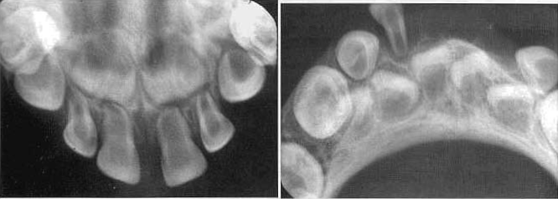
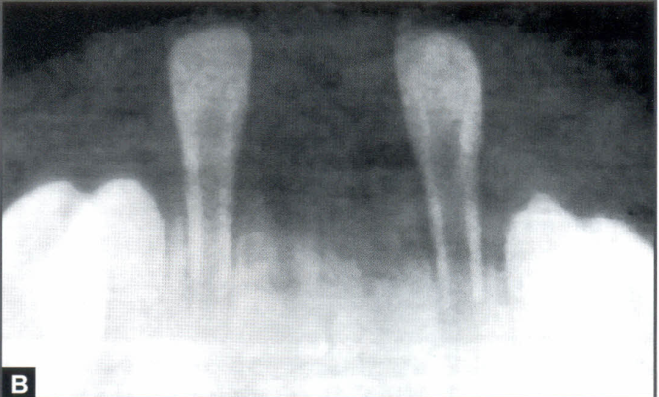
Radiographic changes associated With the teeth:
Both primary and permanent teeth have a thin enamel layer and large pulp chambers and root canals .
The teeth may also be hypoplastic and may be lost prematurely.

Slide 107
Renal Osteodystrophy
Synonym
Renal rickets
Definition
In renal osteodystrophy, bone changes result from chronic renal failure.
The kidney disease interferes with the hydroxylation of 25(OH)D into 1,25(OH)2D, which normally occurs in the kidney.

Slide 108
Affected patients often have hypocalcemia as a result of impaired calcium absorption and hyperphosphatemia resulting from reduction in renal phosphorus excretion.
A prolonged low serum level of calcium stimulates the parathyroid glands to produce PTH.
The result is a secondary hyperparathyroidism.

Slide 109
Clinical features:
The clinical features of renal osteodystrophy are those of chronic renal failure.
In children, growth retardation and frequent bone fractures may occur.
Adults may experience a gradual softening and bowing of the bones.

Slide 110
Radiographic features
General radiographic features.
The radiographic features of renal osteodystrophy are quite variable.
Some changes of the skeleton resemble those seen in rickets, and other changes are consistent with hyperparathyroidism, including generalized loss of bone density and thinning of bony cortices.

Slide 111
Radiographic features of the jaws:
In renal osteodystrophy the density of the mandible and maxilla may be less than normal" and occasionally may be greater than normal.
Manifestations include a decrease or an increase in the number of internal trabeculae, and the trabecular bone pattern may be granular.
The cortical boundaries may be thinner or less apparent.
It is important to note that these bone changes may persist after a successful renal transplant because of hyperplasia of the parathyroid glands, resulting in a continued elevation of PTH.

Slide 112
Radiographic changes associated with the teeth:
Hypoplasia and hypo calcification of the teeth are possible, sometimes resulting in loss of any radiographic evidence of enamel.
The lamina dura may be absent or less apparent in instances of bone sclerosis

Slide 113
HYPOPHOSPHATEMIA
Synonym
Vitamin D-resistant rickets,
rickets

Slide 114
Definition
Hypophosphatemia represents a group of inherited conditions that produce renal tubular disorders resulting in excessive loss of phosphorus.
There is a failure to reabsorb phosphorus in the distal renal tubules, which results in a decrease in serum phosphorus (hypophosphatemia).
Normal calcification of the osseous structures requires the correct amount and ratio of serum calcium and phosphorus.
Multiple myeloma may induce hypophosphatemia as a result of secondary damage to the kidneys.

Slide 115
Clinical Features
Children with hypophosphatemia show reduced growth and rickets-like bony changes.
These include bowing of the legs, enlarged epiphyses, and skull changes.
Adults have bone pain, muscle weakness, and vertebral fractures.

Slide 116
Radiographic Features
General radiographic features:
In children with hypophosphatemia, radiographic findings are indistinguishable from those of rickets.
In adults the long bones may show persistent deformity, fractures, or pseudofractures

Slide 117
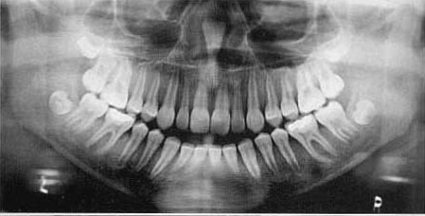
Radiographic features of the jaws:
The jaws are usually osteoporotic and in extreme cases are remarkably radiolucent.
Cortical boundaries may be unusually radiolucent or not apparent .
Other possibilities include fewer visible trabeculae and a granular trabecular pattern.

Slide 118
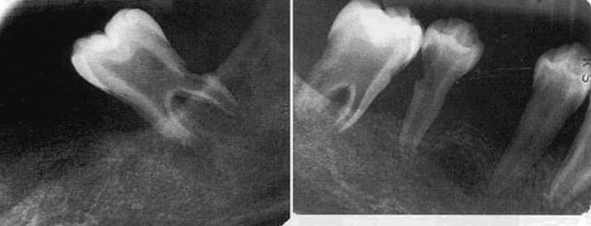
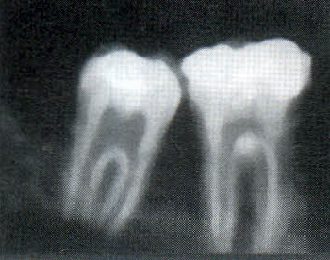
Radiographic features associated with the teeth:
The teeth may be poorly formed, with thin enamel caps and large pulp chambers and root canals

Slide 119
In addition, periapical and periodontal abscess occur frequently.
The occurrence of periapical rarefying osteitis without an etiology may be a result of large pulp chambers and defects in the formation of dentin.
This may allow for the ingress of oral microorganisms and subsequent pulp necrosis.
If the disease is severe, the patient experiences premature loss of the teeth.
The lamina dura may become sparse, and cortical boundaries around tooth crypts may be thin or entirely absent.

Slide 120
OSTEOPETROSIS
Synonyms
Albers-Schonberg and marble bone disease

Slide 121
Definition
Osteopetrosis is a disorder of bone that results from a defect in the differentiation and function of osteoclasts.
The lack of normally functioning osteoclasts results in abnormal formation of the primary skeleton and a generalized increase in bone mass.
The failure of normal bone remodeling results in dense, fragile bones that are susceptible to fracture and infection.
Obliteration of the marrow compromises hematopoiesis and compresses cranial nerves.

Slide 122
Inherited as an
autosomal recessive type (osteopetrosis congenita) and
autosomal dominant type (osteopetrosis tarda).

Slide 123
Clinical Features
The more severe, recessive form of osteopetrosis is seen in infants and young children, and the more benign, dominant form appears later.
The severe form is invariably fatal early in life.
The patient experiences progressive loss of the bone marrow and its cellular products and a severe increase in bone density.

Slide 124
The narrowing of bony canals results in hydrocephalus, blindness, deafness, vestibular nerve dysfunction, and facial nerve paralysis.
The benign, dominant form is milder and may be entirely asymptomatic.
It may be discovered any time from childhood into adulthood.
The disease may be found as an incidental finding or appear as a pathologic fracture of a bone.

Slide 125
In some of the more chronic cases, bone pain and cranial nerve palsies caused by neural compression may be clinical problems.
Osteomyelitis may complicate this disease because of the relative lack of vascularity of the dense bone.
This problem is more common in the mandible, whereas osteomyelitis is usually secondary to dental or periodontal disease.

Slide 126
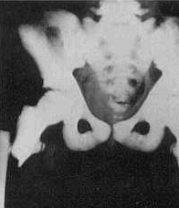
Radiographic Features
General radiographic features.
In the classic radiographic presentation of osteopetrosis, all bones show greatly increased density, which is bilaterally symmetric.
The increased density throughout the skeleton is homogeneous and diffuse.

Slide 127
The internal aspect of the involved bone may be so dense or radiopaque that the trabecular patterns of the medullary cavity may not be visible.
The internal radiopacity also reduces the contrast between the outer cortical border and the cancellous portion of the bone.
The entire bone may be mildly enlarged.

Slide 128
Radiographic features of the jaws:
The increased radiopacity of the jaws may be so great that the radiographic image may fail to reveal any internal structure and even the roots of the teeth may not be apparent.
The increased bone density and relatively poor vascularity results in a susceptibility of the mandible to osteomyelitis, usually from odontogenic inflammatory lesions.

Slide 129
Radiographic features associated with the teeth:
Effects on teeth. may include delayed eruption, early tooth loss, missing teeth, malformed roots and crowns, and teeth that are poorly calcified and prone to caries.
The normal eruption pattern of the primary and secondary dentition may be delayed as a result of bone density or ankylosis.
The lamina dura and cortical borders may appear thicker than normal.

Slide 130
Treatment
Treatment of osteopetrosis consists of bone marrow transplants to attempt to stimulate the formation of functional osteoclasts and systemic steroids for the hematologic component.
The osteomyelitis is difficult to treat, and a combination of antibiotics and hyperbaric oxygen therapy is used.
It is imperative that affected patients avoid odontogenic inflammatory disease.

Slide 131
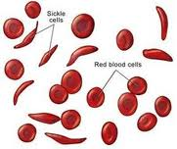
SICKLE CELL ANEMIA
Definition
Sickle cell anemia is an autosomal recessive, chronic, hemolytic blood disorder.
Patients with this disorder have abnormal hemoglobin (deoxygenated hemoglobins), which under low oxygen tension results in sickling of the red blood cells.
These blood cells have a reduced capacity to carry oxygen to the tissues and, because of damage to their membrane lipids and proteins, adhere to vascular endothelium and obstruct capillaries.

Slide 132
The spleen traps and readily destroys these abnormal red cells.
The hematopoietic system responds to the resultant anemia by increasing the production of red blood cells, which requires compensatory hyperplasia of the bone marrow.

Slide 133
Homozygous Type- here the whole of HbA is replaced by HbS and is called sickle cell disease.
Heterozygous Type- only 50% of the HbA is replaced by HbS and is known as sickle cell trait.

Slide 134
Symptoms and signs vary considerably, most patients with the disease normally manifest mild, chronic features.
Long, quiet spells of hemolytic latency occur, occasionally punctuated by exacerbations known as sickle cell crises .
During the crisis state,
severe abdominal, muscle, and joint pain,
have a high temperature,
Circulatory collapse.
During milder periods the patient may complain of fatigability, weakness, shortness of breath, and muscle and joint pain.

Slide 135
As in the other chronic anemias, the heart is usually enlarged and a murmur may be present.
The disease occurs mostly in children and adolescents.
It is compatible with a normal life span, although many patients die of complications of the disease before the age of 40 years.

Slide 136
Radiographic Features:
The hyperplasia of the bone marrow at the expense of cancellous bone is the primary reason for the radiographic manifestations of sickle cell anemia

Slide 137
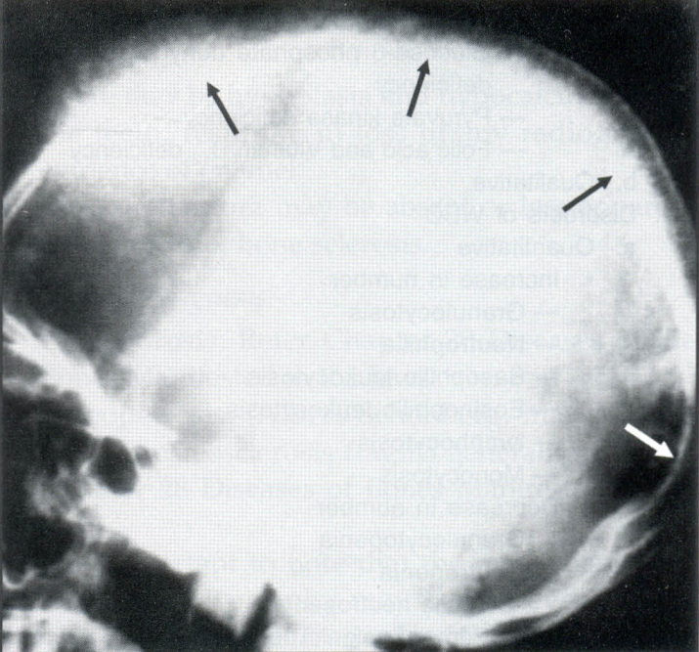
General radiographic features:
The thinning of individual cancellous trabeculae and cortices is most common in the vertebral bodies, long bones, skull, and jaws.
The skull may have widening of the diploic space and thinning of the inner and outer tables

Slide 138
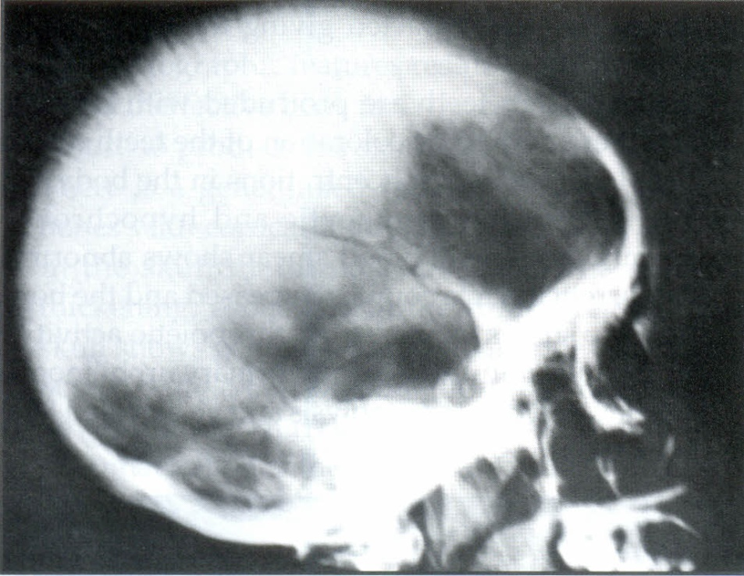
In extreme cases (5%) the outer table of the skull will not be apparent and a hair-on-end appearance may occur.
Small areas of infarction may be present within bones after blockage of the microvasculature; these are seen radiographically as areas of localized bone sclerosis.

Slide 139
Osteomyelitis may complicate sickle cell anemia if infection begins in an area of pronounced hypovascularity.
There may also be retardation of generalized bone growth.

Slide 140
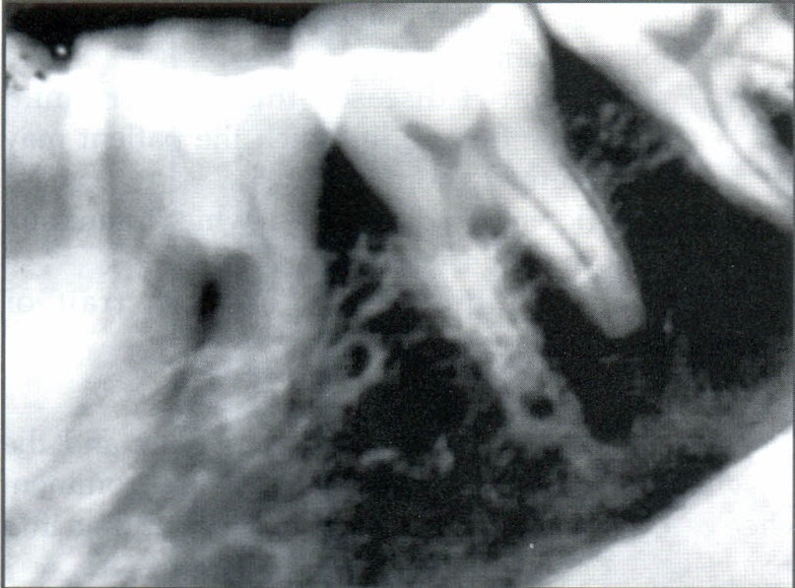
Radiographic features of the jaws:
general osteoporosis - because of a decrease in the volume of trabecular bone
thinning of the cortical plates.
The bone pattern may be altered to one with fewer but coarser trabeculae

Slide 141
In inter dental portions of the jaws, the trabeculae are coarser and appear as horizontal rows creating a step ladder effect.

Slide 142
Radiographs of the jaws of children -high frequency of severe osteoporosis.
Rarely, bone marrow hyperplasia may cause enlargement and protrusion of the maxillary alveolar ridge.

Slide 143
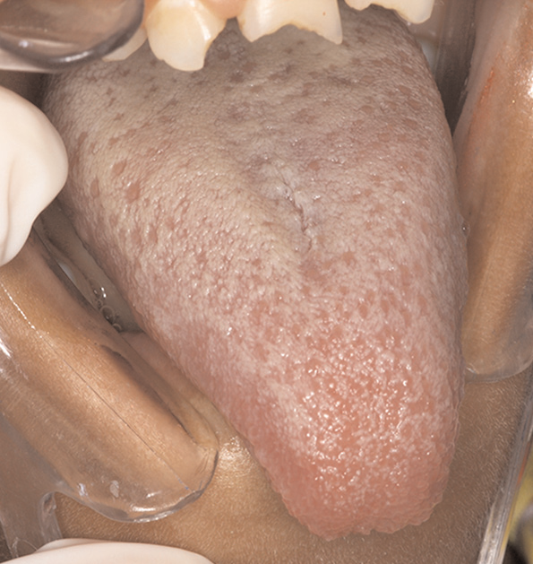
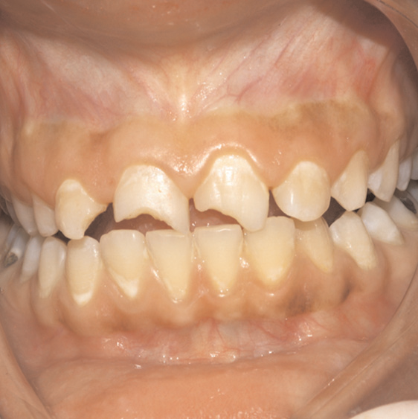
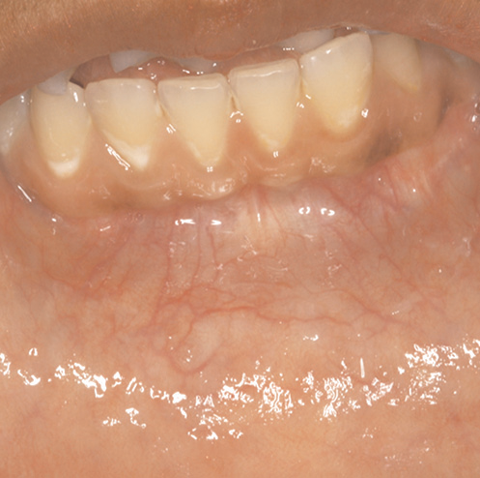
Oral Considerations in the Management of Sickle Cell Disease: A Case Report
OHDM - Vol. 11 - No. 3

Slide 144
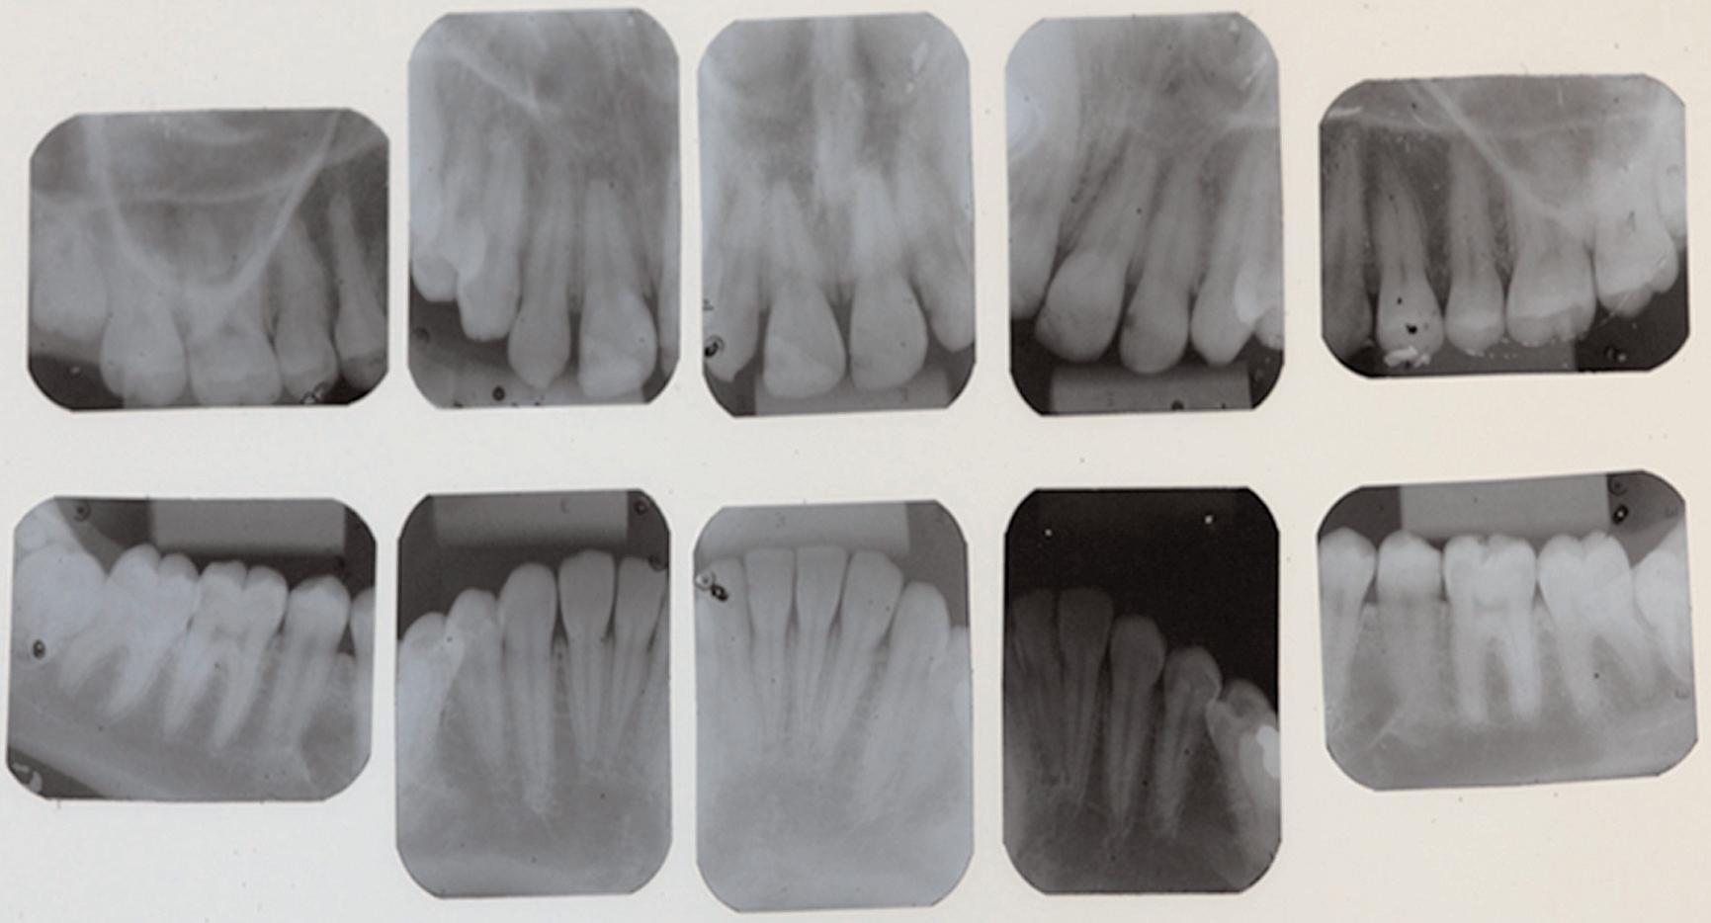

Slide 145
THALASSEMIA
Synonyms
Cooley's anemia, Mediterranean anemia, and erythroblastic anemia.
Definition
Thalassemia is a hereditary disorder that results in a defect in hemoglobin synthesis.
This defect may involve either the alpha or beta globulin gene.

Slide 146
Heterozygous form (thalassemia minor)
Homozygous form (thalassemia major)

Slide 147

Clinical Features
In the severe form of the disease, the onset is in infancy and the survival time may be short.
The face develops prominent cheekbones and a protrusive premaxilla, resulting in a "rodent-like" face.
The milder form of the disease occurs in adults.

Slide 148
Radiographic Features
General radiographic features:
Result from hyperplasia of the ineffective bone marrow and its subsequent failure to produce normal red cells.

Slide 149

Generalized radiolucency of the long bones with cortical thinning.
In the skull the diploic space exhibits marked thickening, especially in the frontal region.

Slide 150

The skull shows a generalized granular appearance and occasionally a hair-on-end effect may develop.

Slide 151

Radiographic appearance of the jaws:
prevents pneumatization of the paranasal sinuses, especially the maxillary sinus, and causes an expansion of the maxilla that results in malocclusion

Slide 152

The jaws appear radiolucent, with thinning of the cortical borders and enlargement of the marrow spaces.

Slide 153

The trabeculae are large and coarse .
The lamina dura is thin, and the roots of the teeth may be short.

Slide 154

CASE REPORT
Thalassemia major: A case report
J. Int Oral Health 2011

Slide 155


Slide 156



Slide 157
Erythroblastosis Fetalis (Hereditary
Disease of The Newborn)
Definition:
This occurs due to isoimmune antibodies.
Congenital hemolytic anemia results due to Rh incompatibility which results in destruction of fetal blood brought about by the reaction between maternal and fetal blood factors.

Slide 158
There is deposition of blood pigment in enamel and dentin of developing teeth giving them a green, brown or blue hue.
Enamel hypoplasia, which involves the incisal edges of anterior teeth and the middle portion of the deciduous cuspid and first molar crown.
It presents as a ring like defect called as Rh hump.

Slide 159
Radiographic Features
Transverse lines of increased and decreased radiolucency, occurs at the ends of some long bones in some cases.
There is increased thickness of the cranial bone which also includes the maxilla and the mandible.
The bones of the vault are thickened as a result of increased thickness of diploe, radiating spicules may be present.

Slide 160
Agranulocytopenia (Granulocytopenia, Agranulocytic Angina)
Definition:
This is characterized by marked leucopenia with reduction and absence of neutrophilic leukocytes .

Slide 161
PROGRESSIVE SYSTEMIC SCLEROSIS
Synonym
Scleroderma
Definition
Progressive systemic sclerosis (PSS) is a generalized connective tissue disease that causes hardening (sclerosis) of the skin and other tissues.

Slide 162
Clinical Features
PSS is a disease of middle age, with the greatest incidence between the ages of 30 and 50 years.
It is rarely seen in adolescents or older adults.
Women are affected about three times as often as men.

Slide 163


In most patients with moderate to severe PSS, the involved skin has a thickened, leathery quality.
The skin is not mobile over the underlying soft tissues, and involvement of the facial region may inhibit normal mandibular opening.

Slide 164
Patients with diffuse disease are also likely to have xerostomia; increased numbers of decayed teeth.

Slide 165
Patients with systemic disease are more likely to have deeper periodontal pockets and higher gingivitis scores.
Patients with cardiac and pulmonary problems may have varying degrees of heart failure and respiratory insufficiencies.
Renal involvement usually leads to some degree of uremia, with or without hypertension.

Slide 166

Radiographic Features
Radiographic features of the jaws:
A radiographic feature in some cases of PSS is an unusual pattern of mandibular erosions at regions of muscle attachment such as the angles, coronoid process, digastric region, or condyles

Slide 167
This type of resorption is typically bilateral and fairly symmetric.
Most of these erosive borders are smooth and sharply defined.
This resorption may be progressive with the disease.

Slide 168

Radiographic changes associated with the teeth.
The most common oral radiographic manifestation of PSS is an increase in the width of the periodontal ligament (PDL) spaces around the teeth

Slide 169
mandibular erosive bone changes.
Management:
The aforementioned thickening of PDL spaces does not seem to present any clinical difficulties.
The progressive loss of bone in the region of the mandibular angle, however, is more serious because of potential fracture.
It is reasonable to obtain initial and periodic panoramic radiographs in all patients with PSS to assess mandibular integrity

Slide 170
THANK U

